Slide 1

Building a Knowledge Spine
Voice-to-Text, Debriefs and AI-Ready Knowledge Bases That Actually Get Used
John D. Tocado

Slide 2

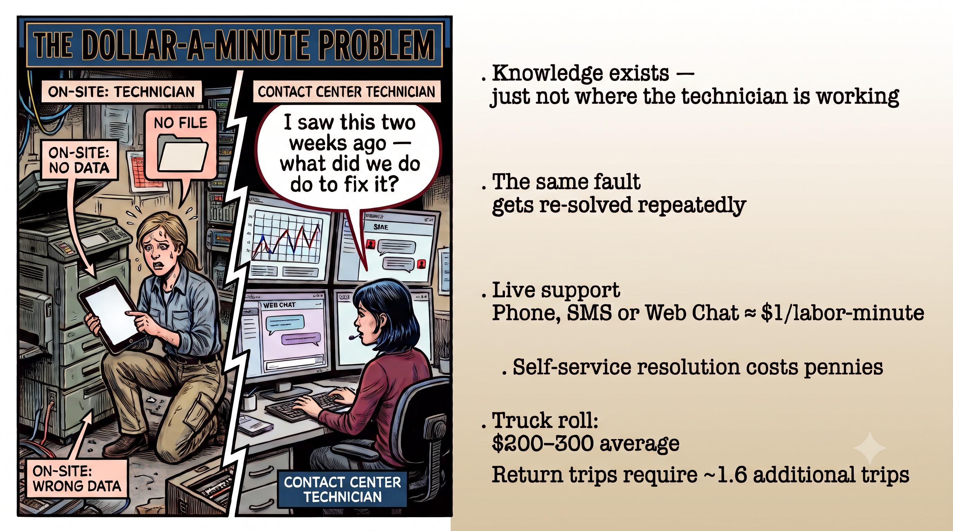
The Dollar-A-Minute Problem
Knowledge exists – just not where the technician is working
The same fault gets re-solved repeatedly
Live support at least $1.00 a minute
Truck rolls cost hundreds
SelfServe costs pennies

Slide 3
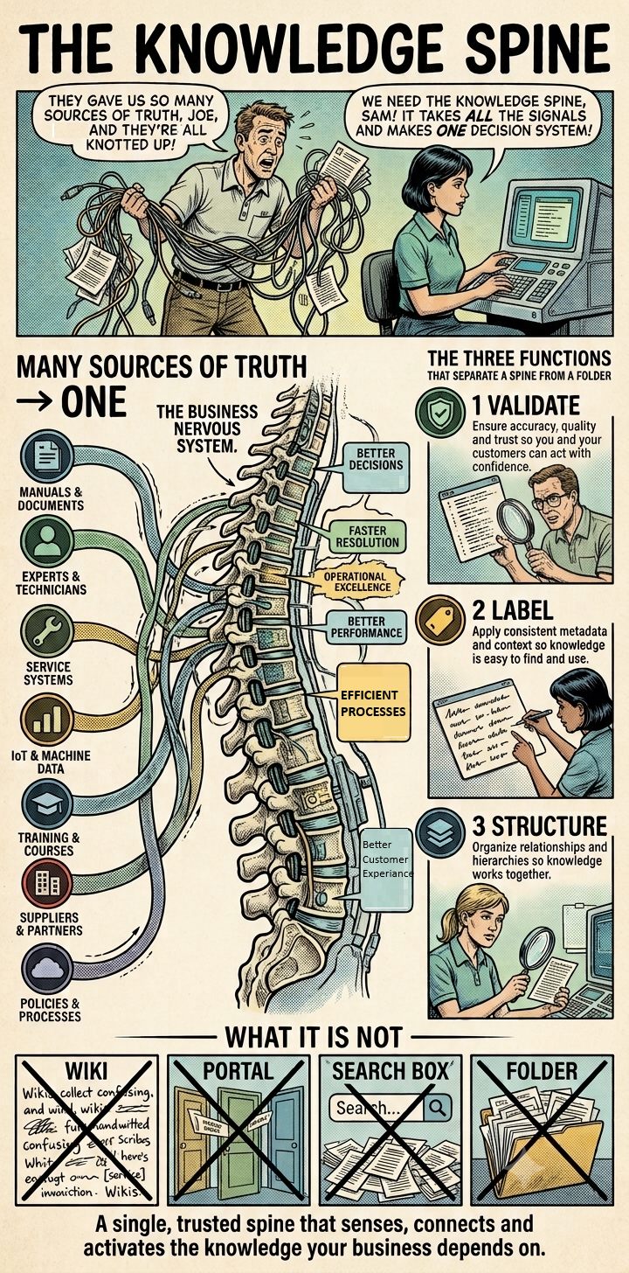
The Knowledge Spine
It's not Storage
It is an active layer that ingests All your sources of data
What it does:
  Validates
  Labels
  Structures
What do you get?
  A single source of data
  Data formatted for the time the task and the user
  Governance to keep the data accurate

Slide 4
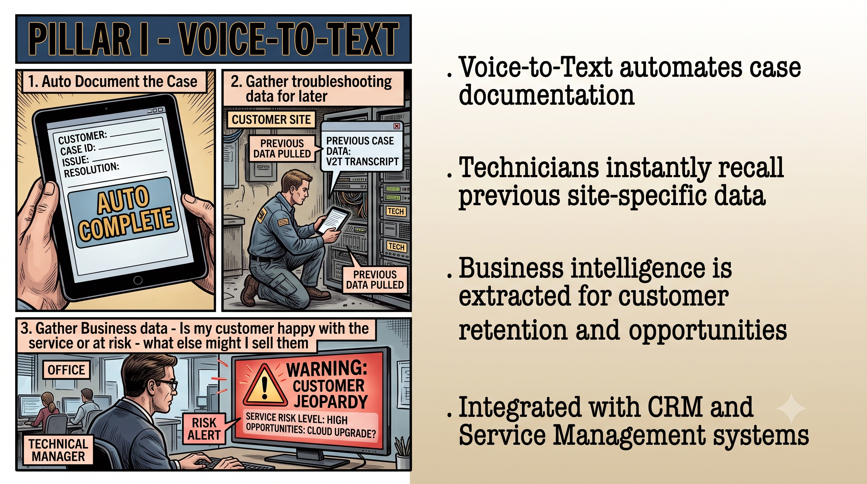
Pillar I – Voice to Text
Get the Data in the Now
Voice-to-Text automates case documentation
Technicians instantly recall previous site-specific data
Business intelligence is extracted for customer and retention opportunities
Integrates with CRM and Service Management Systems

Slide 5
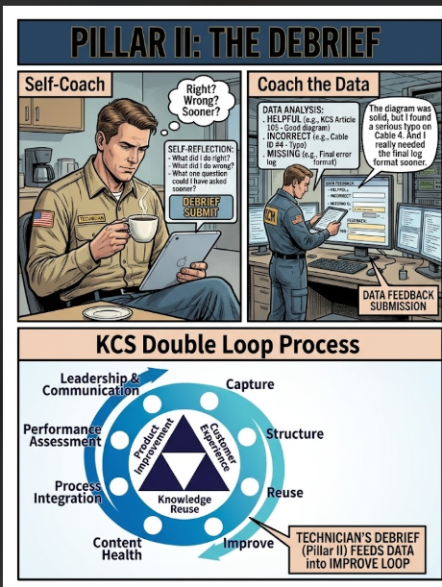
Pillar II: The Debrief
  Self-Coach
    What did I do right?
    What did I do wrong?
    What one question could I have asked sooner?
  Coach the Data
    Here is where data gets tagged as true or not true and edited and reported back to the knowledge spine
  Knowledge Centered Success
    Consortium for Service Innocation

Slide 6
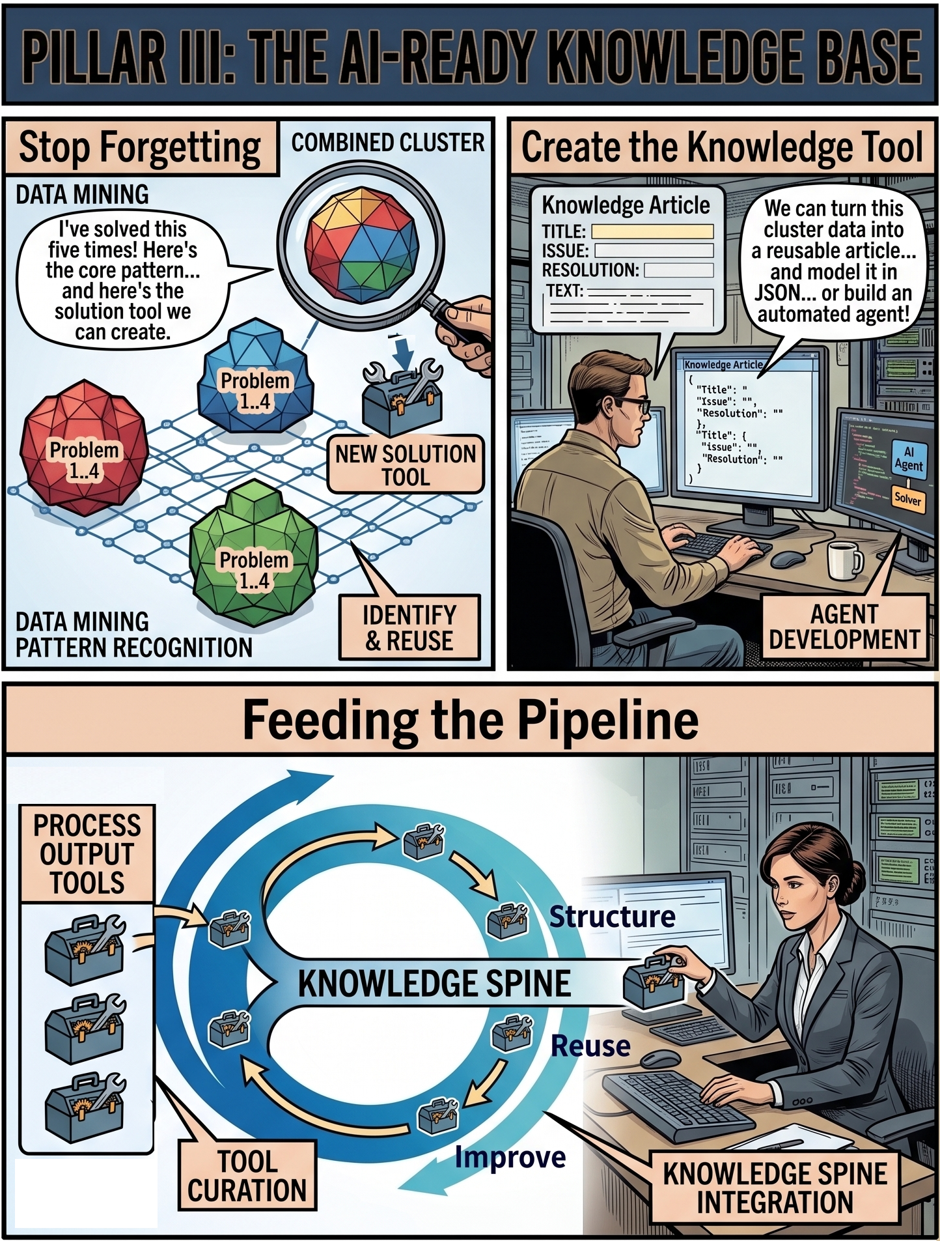
Pillar III
The AI-Ready Knowledge Base
Stop forgetting
  Notice the problems you solve repeatedly
  Build autonomous AI Agents to identify and gather data from problem clusters
Create a tool based on that knowledge
  Knowledge Articles
  Structured Data for lookup
  AI Coaches
Data Governance
  Curates and places tools back into the core Knowledge Spine pipeline

Slide 7
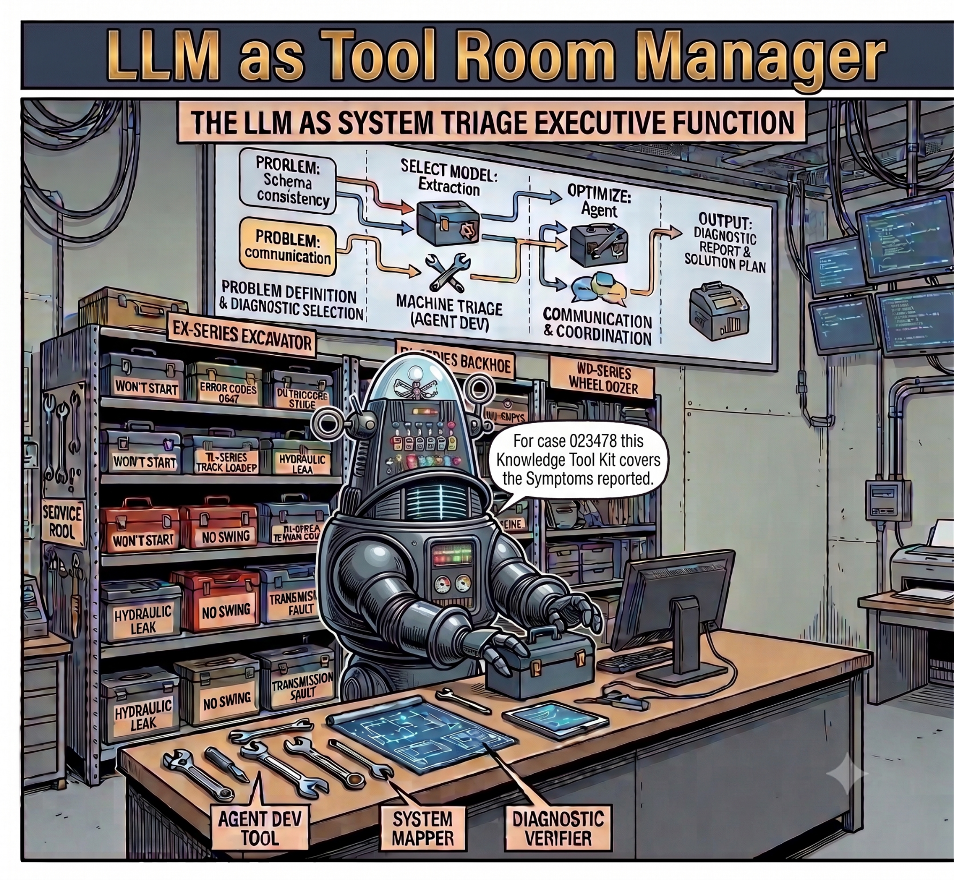
Tool Room Manager
LLM as Executive Function
“The spine holds the truth.
The model decides what to surface,
to whom, and how
nothing more.”

Slide 8
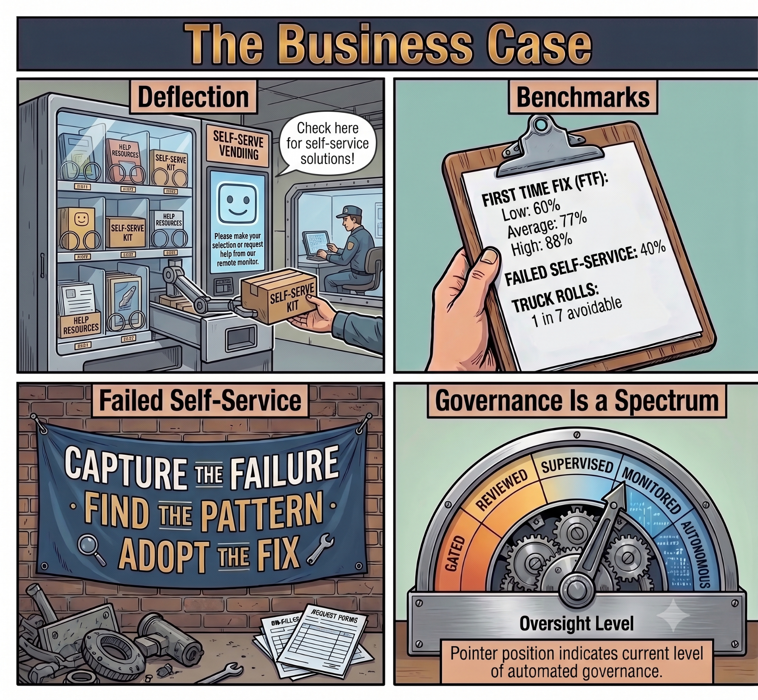
Business Case
The reward for the risk
Deflection
  Cost Pennys
Benchmarks
  First Time Fix
    Low: 60%
    Average 77%
    High 88%
Self-Service
  81% of customers try
  40% call anyway
Governance
  Human to Fully Auto

Slide 9
Partial Vendor List
Vendor | Spine layer served | How they deliver it
eGain AI Knowledge Hub | Validate & structure; serve; LLMOps | KCS-verified knowledge platform; connectors unify content from CRM, SharePoint and other repositories without migration; an AI agent surfaces confidence-ranked answers in the workflow; a built-in evaluator scores every AI response and flags regressions when content changes.¹²
Coveo | Structure & serve (retrieval) | AI search and relevance layer that unifies and ranks content across many repositories and grounds generative answers — a retrieval backbone for enterprise knowledge.
Stonly | Structure & serve (guided) | Interactive, branching step-by-step guides that adapt to the user’s answers; oriented to deflection and guided troubleshooting embedded in-product rather than static articles.
Bloomfire | Capture & structure | Knowledge-management / enterprise-intelligence platform emphasizing searchable shared knowledge and the capture of tacit, communities-of-practice expertise.
Guru | Structure & serve | Workflow-embedded knowledge with AI answers and a verification cadence that keeps articles trusted and current where people already work.
Glean | Serve (retrieval) | Enterprise work assistant that grounds answers by searching across connected company applications with permission-aware retrieval.
Next Steps
Data Audit
Engage Your People
Start Talking to Professionals

Slide 10

Thank You
Additional Resources
Email
  John.tocado@BlueCadence.tech
Phone
  610-866-4080
https://bluecadence.tech/pages/FieldServiceEast2026.html

